Slide 1


Health Cost Navigator
GROUP 5
RAVINDRA GOLLAPUDI (RXG230005)
NIKHITA SANTOSHI MANDAVA (NSM230000)
AYMAN SIDDIQ RAZA(AXR230060)
PUNYA SRIVALLI NALLAMOTHU (PXN230013)
APARNA MISHRA (AXM230011)
VENKAT BHARGAV NISTHALA(BVN220000)
SIDDHARTH RAO MEESALA(SXM230079)
PARTHSARTHI SHAH(PXS220106)

Slide 2
Scope
This project aims to analyze and compare healthcare treatment pricing data across selected hospitals and insurance providers using publicly available CPT code-based charge lists.
Goal
Our goal is to identify pricing differences and provide early insights on cost variations.
Regions Covered:
Charlotte-Concord-Gastonia, NC-SC
Chicago-Naperville-Elgin, IL-IN-WI
Las Vegas-Henderson-Paradise, NV
Notes:
we are group 5. we are working on a tool called health cost navigator that searches various hospitals and insurance providers to suggest the cheapest available options to the user based on the cpt codes.
For our project we have mainly focused on 4 states, Nevada, Illinois, North Carolina and South Carolina. We have collected price transparency data from hospitals spread across these states and analyzing them to get input and insights that can be help users.

Slide 3
User Personas
Parent
Jack
Age: 35
Situation: Father of three kids managing family healthcare needs with employer-provided insurance
Pain Points: Budget constraints, Frustrated by pricing opacity for routine procedures.
Goals: Optimize spending, plan for anticipated medical costs
Student
Hana
Age: 20-32
Situation: Managing health finances along with student loans and other expenses.
Pain Points: Budget constraints, frustrated by unprecedented medical expenses.
Goals: Optimize spending, plan for anticipated medical costs
Chronic Survivor
Jane
Age: 25-75
Situation: Managing routine monthly checkups
Pain Points: Frustrated by pricing variations for procedures, coordination from multiple specialists
Goals: Optimise spending, plan for anticipated medical costs
Notes:
As part of this project, we spoke with people in our own circles who’ve recently used hospital services.to our surprise: one student paid $900 for a diagnostic test at a private hospital, only to learn later that the same test cost just $300 at a university hospital under the same insurance. The difference wasn’t due to the quality of care—but a lack of cost visibility at a critical moment. For someone living on loans, that $600 loss wasn’t just inconvenient—it was a heavy burden.”
The story is kind of same different user groups. That’s why we built our solution around three key personas—each with unique needs, but a shared goal
Jack, the Parent
Jack is a 35-year-old father of three. He's managing family healthcare with employer insurance. Stressed with the budget constraints.
Hana Luvana, the Student
Hana is in her 20s, balancing student loans with unexpected medical bills is frustrating.
Jack , the Chronic Illness Patient
At 45, Jack is also managing a chronic illness. He deals with routine checkups and sees multiple specialists.
we want to help them all to optimize healthcare spending and plan ahead.”

Slide 4

Data Processing
Data Extraction:
Collected and parsed JSON price transparency data from hospital websites
Data Loading:
Chunking heavy datasets to reduce computation costs
Data Transformation:
Converted wide formats to long formats

Slide 5



Workflow
Data (json,csv)
Parse JSON files into CSV
Raw Data Ingestion
into Snowflake Stage
Data Cleaning
and Preprocessing
Move Clean data to
Snowflake Core
Data Modelling
and Loading
Streamlit
Visualizations and
User Interface

Slide 6
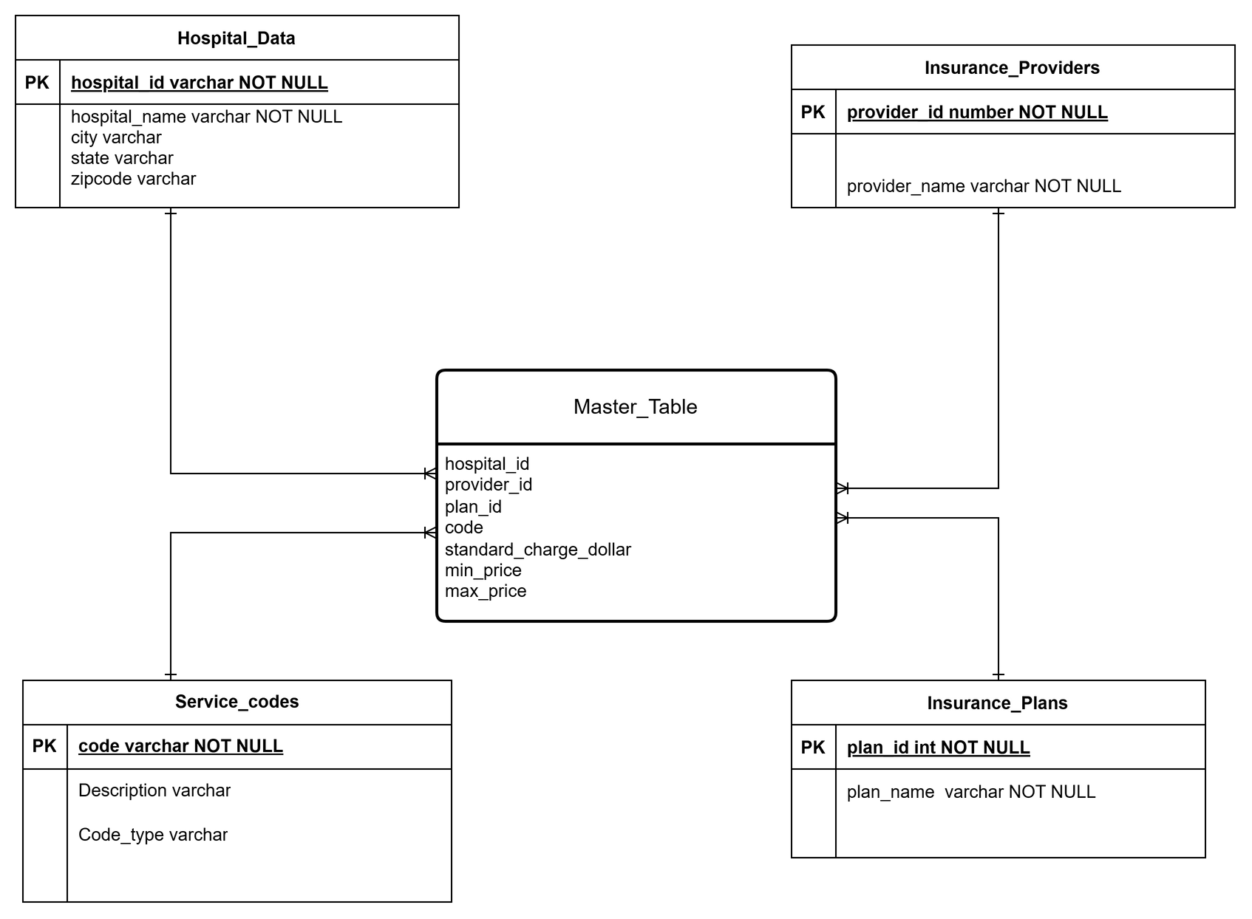
ER Diagram- Star Schema

Slide 7
Key Challenges
01
02
03
04
05
Handling Heavy Data and Multiple Data Formats
Data Inconsistencies in column names, data types.
Duplicate records due to joins when creating fact table
Transposing wide format to long format data
Handling missing data

Slide 8
Why Snowflake
Criteria | Advantages
Context | Handles structured and semi structured data (csv,json) through a cloud database
Ease of Use | Single platform for SQL, python, User Interface creation, and BI
Compute Cost Optimization | Varying the size of warehouse (XS,S,M) helps us manage and optimize the business computation cost. Chunking helped us manage cost.
Automatic Clustering based on usage | Compute auto-suspend/resume eliminates manual turning on/off (cost-efficient ops).
Integration | Supports direct integration with S3 (for future AWS migration).
Governance & Compliance | Built-in HIPAA-ready security features support sensitive healthcare data.

Slide 9

Ingestion Metrics and Dataset Scale
Query Latency: < 10 sec (Snowflake-backed).
Hospitals Analyzed: 17
Data Processed: 2M+ rows
Approximately 38.8k unique CPT codes analyzed
Approximately 160+ insurance plans, and insurance providers

Slide 10

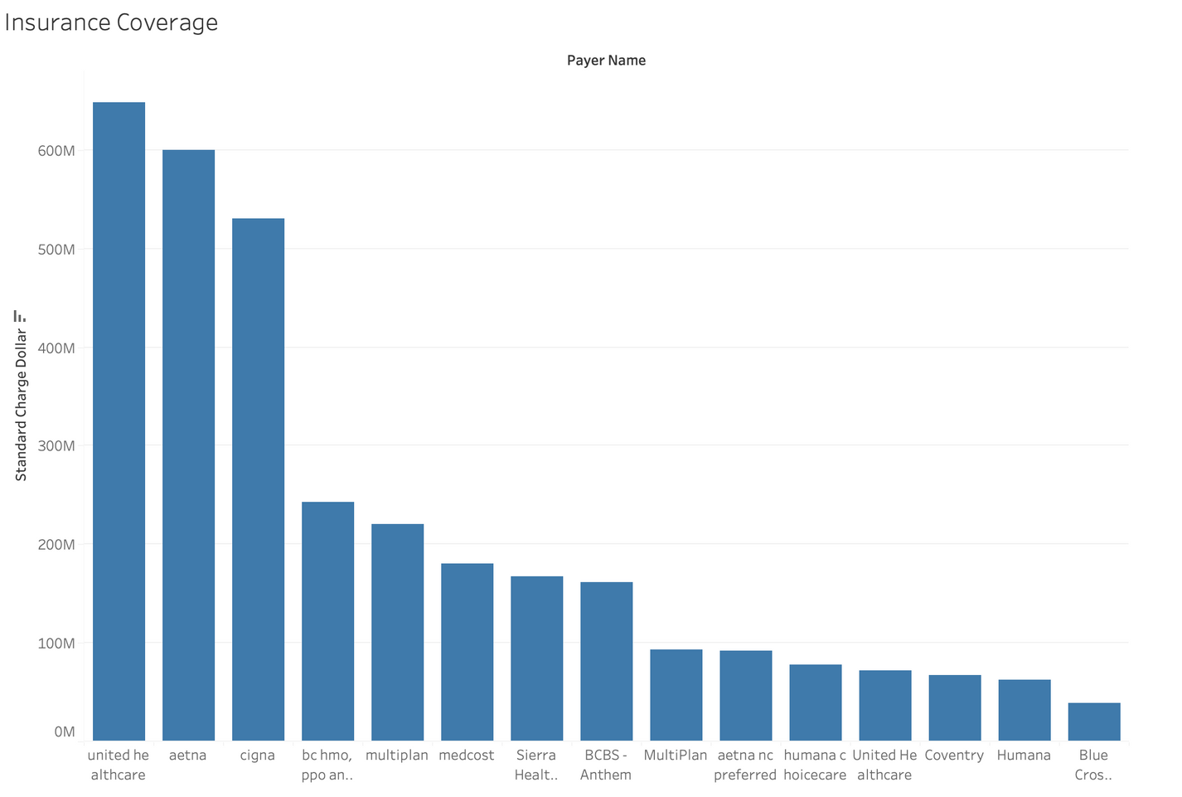
Insights
UnitedHealthcare, Aetna, and Cigna lead in total standard charges billed among insurance providers.

Slide 11
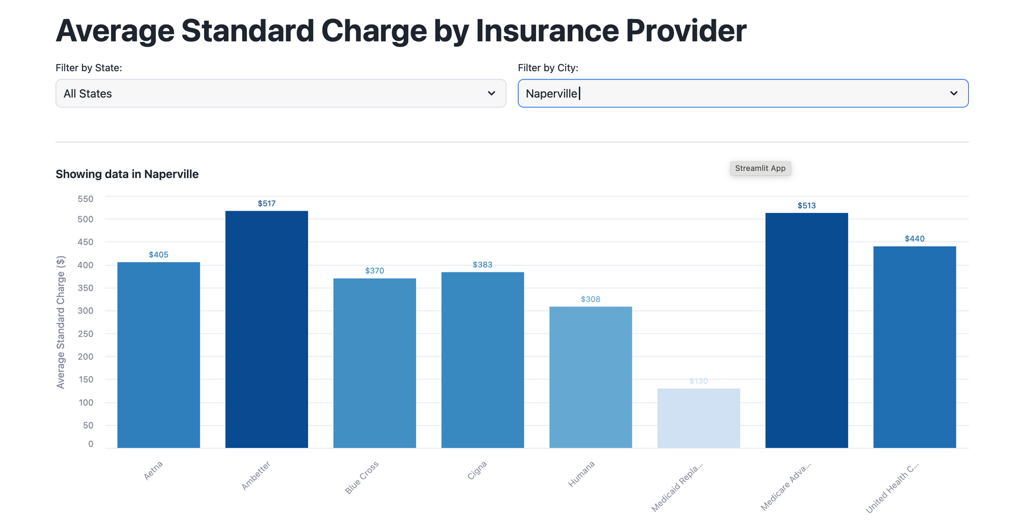
Insights
Visualizations using streamlit app
Ambetter and Medicare Advantage have the highest average standard charges among insurers in Naperville.

Slide 12
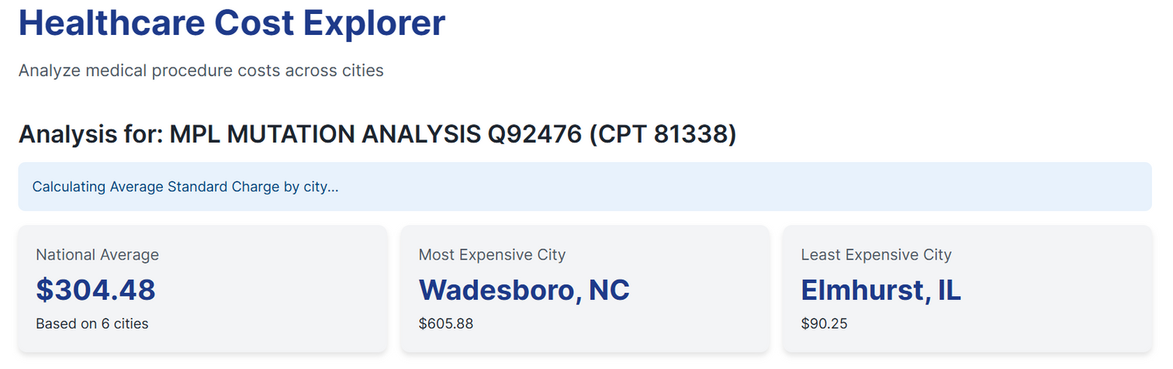
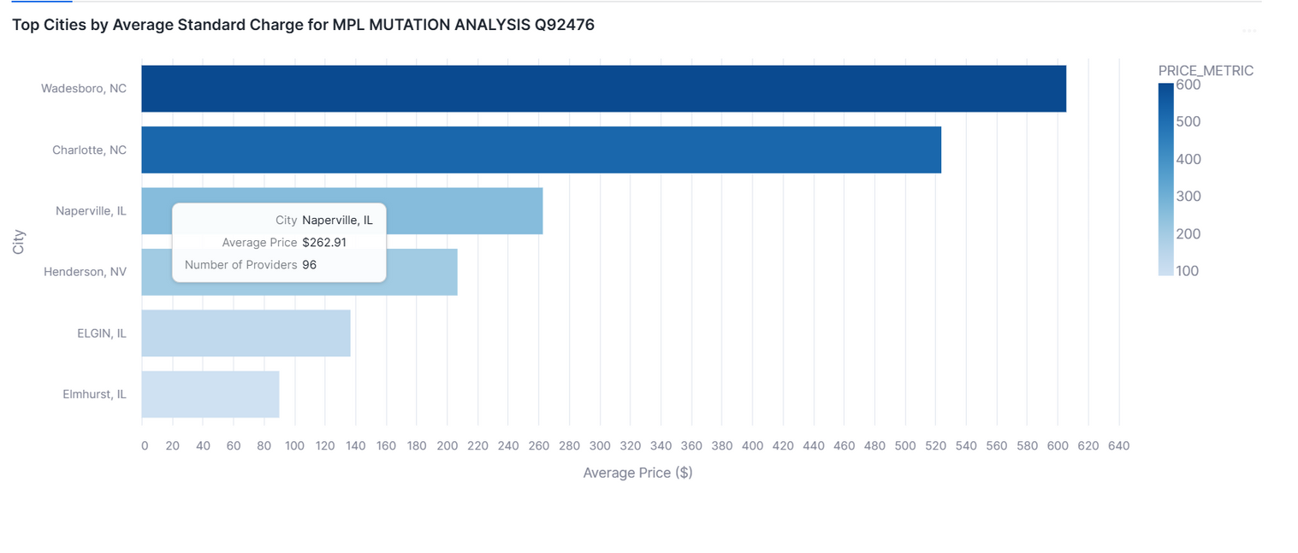
Insights

Slide 13
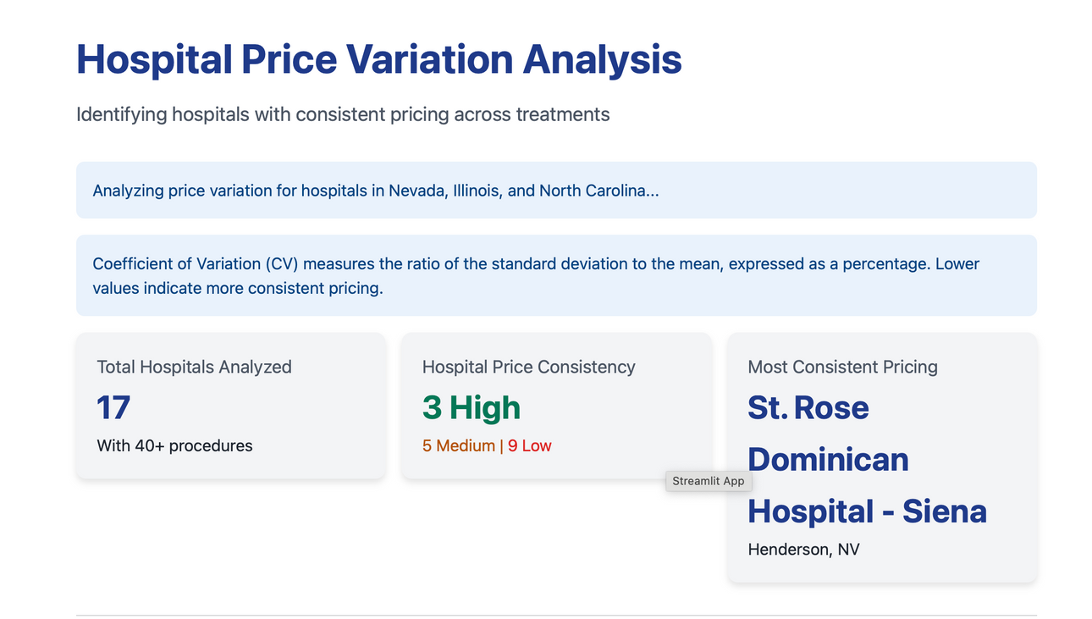
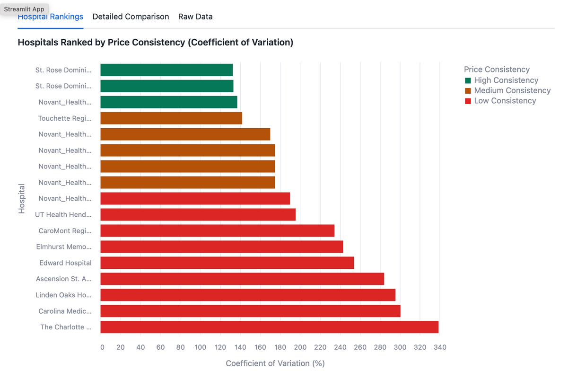
Insights

Slide 14
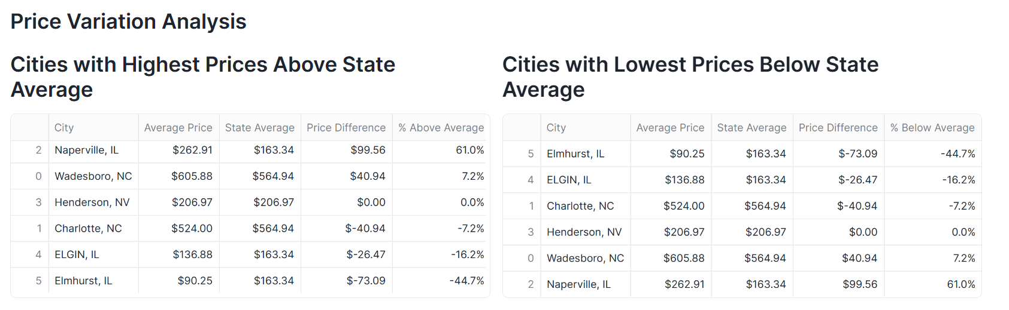
Insights

Slide 15
Live Walkthrough

Slide 16
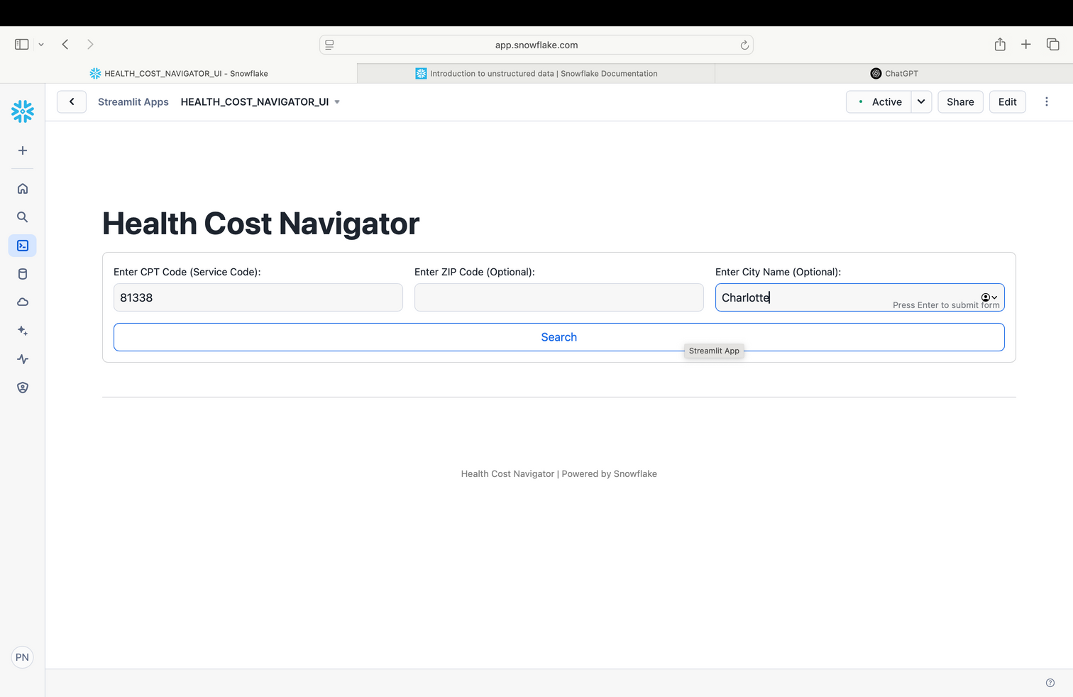
Streamlit User Interface
Search using CPT code, zip code, city, and query health service prices for different hospitals and compare.
Sort is in ascending and descending order.

Slide 17
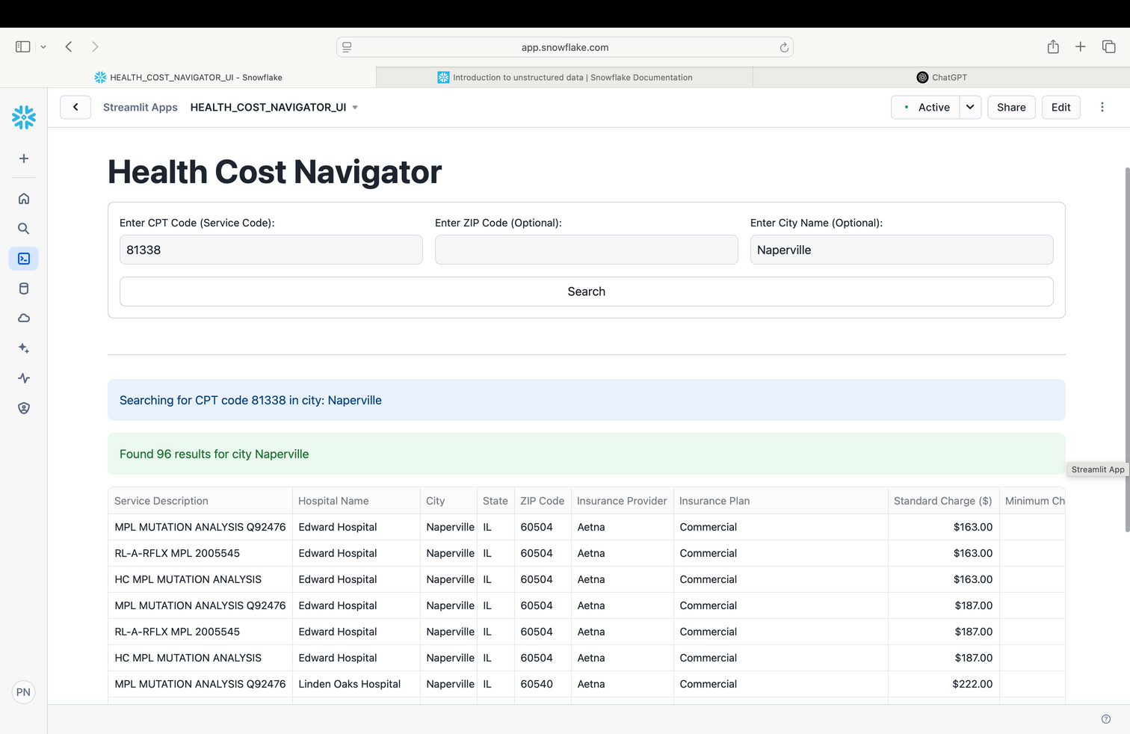
Streamlit User Interface

Slide 18
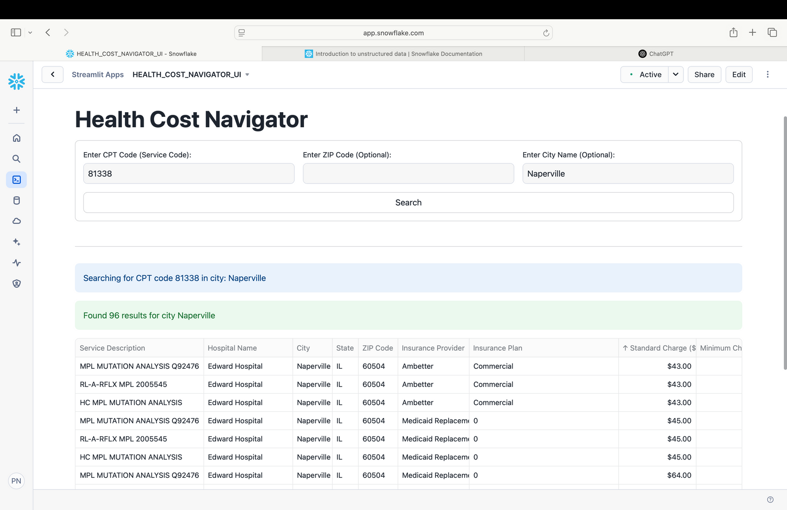
Streamlit User Interface

Slide 19
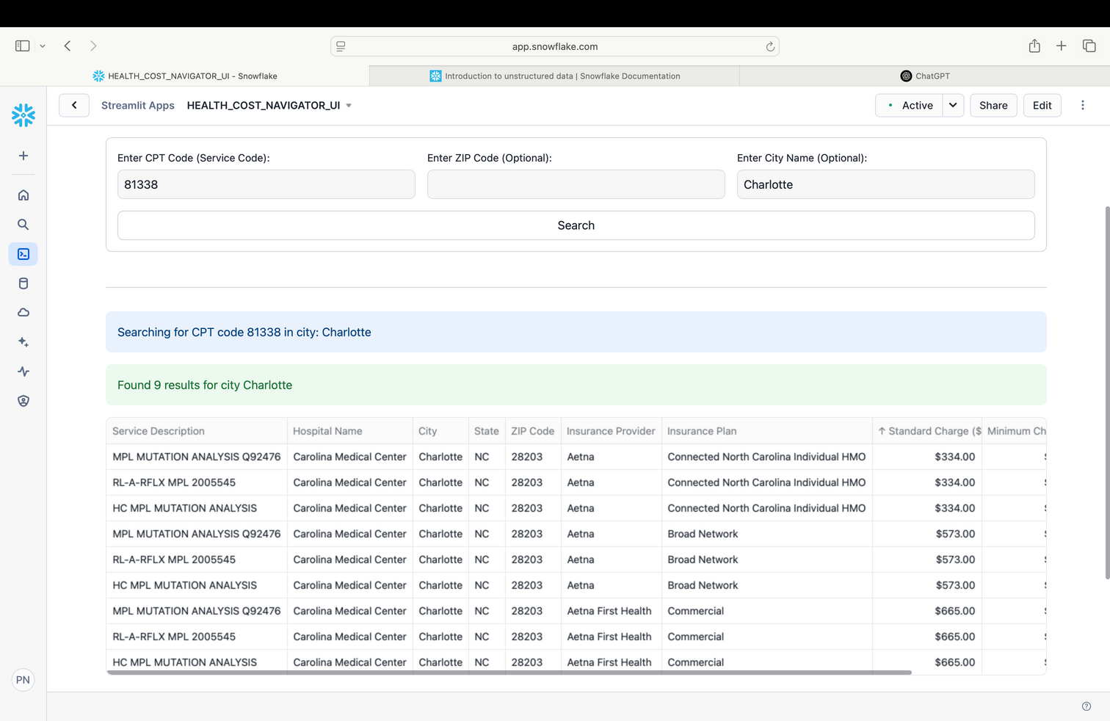
Streamlit User Interface

Slide 20


Thank you

